Slide 1
All About Data Retention
Improving Performance, Compliance, and Architecture!
Edward Pollack
Microsoft Data Platform MVP

Slide 2







Ed Pollack
Microsoft Data Platform MVP
Published author of:
Dynamic SQL: Applications, Performance, and Security, 2nd Edition
Analytics Optimization with Columnstore Indexes in SQL Server
Published in Expert T-SQL Functions in SQL Server, 3rd Edition
Expert Performance Indexing in SQL Server, 4th Edition
Author on Simple Talk.
Organizes:
SQL Saturday New York City
SQL Saturday Albany 2024
Future Data Driven
Capital Area SQL Server User Group
Speaker at many data events
Find me on: LinkedIn

Slide 3














Slide 4
Agenda
The data life cycle
Data Retention: What is it?
Benefits of Retention
Retention strategies
Selling retention to managers/VPs/Execs
Conclusion & questions (?)

Slide 5
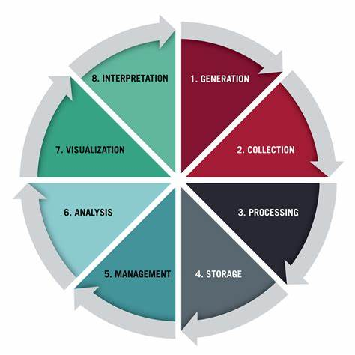
The Data Life Cycle

Slide 6
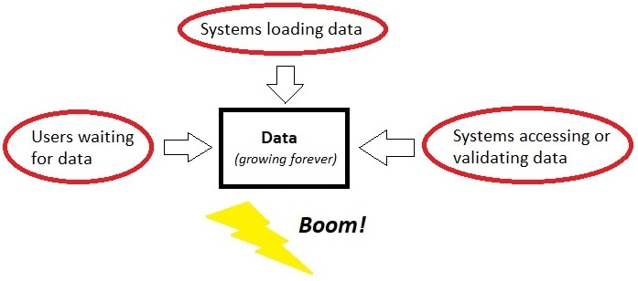
What Can Happen?

Slide 7
Create a Retention Period
Is there ANY chance that data will grow large?
Define a data lifecycle for it.
Define retention periods for its data lifecycle.
This is a business decision first, technical decision second.
This does not have to be time-consuming!!!

Slide 8
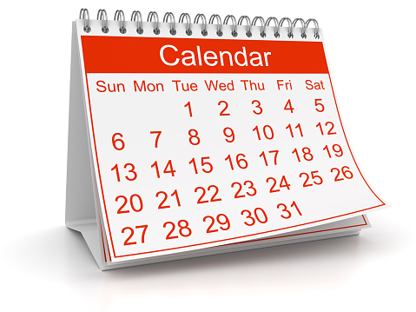
Common Retention Periods
Temporary Data (12 hours, 1 day, etc…)
Short-Term Data (5 days, 2 weeks, etc…)
Mid-Term Data (1 month, 6 months, 1 year)
Long-Term Data (3 years, 5 years, 7 years)
Forever Data (All of eternity?)

Slide 9
RPO/RTO/Availability
Data Retention is directly linked to these:
RPO: Recovery Point Objective
Acceptable data-loss in an emergency.
RTO: Recovery Time Objective
Recovery time in an emergency.
Availability: Uptime for data access.

Slide 10
RPO/RTO/Availability
All things being equal:
Larger data has a longer RTO.
Larger data has a longer RPO.
Larger data takes longer to recover from an emergency.
Spend more money or time to improve this…
…or reduce data size!

Slide 11
Special Types of Data
Internal vs. external
Log data
Temporary data
Transient data
Posterity data (aka: “Just in case” data)

Slide 12
Retention Strategies
MANY ways to apply retention to data.
Strategies can easily be combined.
Align retention strategies with:
Business needs
Cost
Performance
Compliance

Slide 13
Retention Strategy: Delete Data
Simplest form of retention.
If older data is not needed, simply delete it!
Remember to index datetime column, if needed.
DELETE TOP (1000) OrderChangeLog
FROM dbo.OrderChangeLog
WHERE OrderChangeLog.ModifiedDateTime <=
DATEADD(MONTH, -12, GETUTCDATE());
WHILE @@ROWCOUNT > 0
BEGIN
DELETE TOP (1000) OrderChangeLog
FROM dbo.OrderChangeLog
WHERE OrderChangeLog.ModifiedDateTime <=
DATEADD(MONTH, -12, GETUTCDATE());
END;

Slide 14
Retention Strategy: Archive Data
Data is not needed by an application, but must be retained for other purposes, or posterity.
Create new location for it and move it.
Can be in the same database/server or different.
May treat as analytic data once archived.
Can often be (heavily) compressed.
This is a good alternative to data deletion when people are nervous about permanently deleting data!

Slide 15
Retention Strategy: Remove Some Data
Some larger columns are not needed after a retention period.
Notes, description, error log details, etc…
Can NULL/blank/drop freely.
If archiving, then target can omit unneeded data elements entirely.

Slide 16
Retention Strategy: Compression
Older/less used data can often be compressed.
Analytic data can be compressed
ROW/PAGE compression.
Columnstore compression.
Parquet compression.
File compression.

Slide 17
Retention Strategy: Partitioning
Physically/logically split up a table into separate files.
Each part may be compressed differently (or not).
Partition truncation/split/merge can be used.
Partition elimination can improve performance.
Automate retention processes with partition magic!

Slide 18
Retention Strategy: Turn OLTP into OLAP
Old data not used by an app anymore?
Rarely/never written to?
Adjust to analytic data storage/conventions.
Columnstore indexes
Heavy compression
Data lake
Data warehouse
Dedicated analytics engine?

Slide 19
Retention Strategy: Other
3rd party applications
Hardware solutions
Deduplication
Hosted data management platforms
Other?

Slide 20
Notes on Timing
Retention is data manipulation
Deletion
Updates
Data movement
Etc…
Treat retention as maintenance
Perform off-hours, or when tolerable
Avoid conflicts with other processes

Slide 21
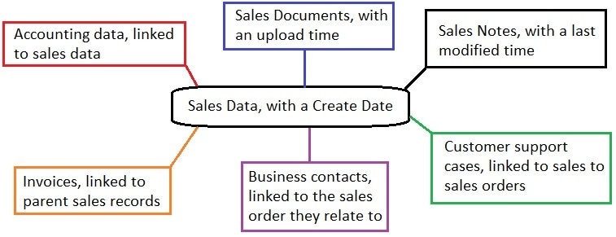
Relational Data Retention
When data has related data, consider carefully what a retention period entails:

Slide 22
Conclusion
Retention is a key part of database design/architecture!
Effective retention can:
Improve performance
Reduce data footprint
Improve compliance
Improve organizational communication
Creating/owning retention policies is a leadership/collaboration opportunity!

Slide 23


Session Evaluation Win 6x$50 gift card
Event Evaluation Win $100 gift card

Slide 24
Thank You!
Find me here:
ed@edwardpollack.com
Ed Pollack | LinkedIn
Find my content here:
EdwardPollack (Ed Pollack) (github.com)
Edward Pollack, Author at Simple Talk (red-gate.com)
Ed Pollack, Author at SQL Shack - articles about database auditing, server performance, data recovery, and more

